Slide 1
Introduction to SAP Ecosystem

Slide 2
What is SAP?
SAP is one of the world’s leading producers of software for the management of business processes, developing solutions that facilitate effective data processing and information flow across organizations.
Overview
Founded in 1972, the company was initially called System Analysis Program Development.

Slide 3
Understanding SAP
What does SAP stand for?
The name is an initialism of the company’s original German name: Systemanalyse Programmentwicklung, which translates to System Analysis Program Development. Today the company’s legal corporate name is SAP SE — SE stands for societas Europaea, a public company registered in accordance with the European Union corporate law.

Slide 4
What is SAP software used for?
By centralizing data management, SAP software provides multiple business functions with a single view of the truth. This helps companies better manage complex business processes by giving employees of different department’s easy access to real-time insights across the enterprise.
What does SAP do?
SAP helps companies and organizations of all sizes and industries run their businesses profitably, adapt continuously, and grow sustainably.

Slide 5
ERP Systems
What is ERP Software?
ERP stands for “enterprise resource planning.” ERP software includes programs for all core business areas, such as procurement, production, materials management, sales, marketing, finance, and human resources (HR).
SAP is one of the first companies to develop standard software for business solutions and continues to offer industry-leading ERP solutions.

Slide 6
How does it work?
ERP has evolved over the years from traditional software models that made use of physical client servers and manual entry systems to cloud-based software with remote, web-based access.
In ERP, all departments are tied into the system, all data is collected on the server and becomes instantly available to those with permission to use it. Reports can be generated with metrics, graphs, or other visuals and aids a client might need to determine how the business and its departments are performing.

Slide 7
Benefits of Enterprise Resource Planning
Improve Accuracy & Productivity
Improve Reporting
Increases Efficiency
Increases Collaboration

Slide 8
Popular ERP Systems
SAP Business One
SAP S/4 HANA Cloud
SAP ERP

Slide 9
Evolution of SAP
The journey of SAP ERP from R/1 system to SAP S/4 HANA system
SAP R/1 1972
SAP entered the ERP software domain with its SAP R/1 system. R1 stands for single tier architecture.
SAP R/2 1982
Based on mainframe architecture, SAP R/2 system was designed to manage large global enterprise. R/2 stands for 2 tier architecture.

Slide 10
R/3 followed client-server architecture. R/3 systems could also take advantage of then evolving internet technology.
ECC stands for Enterprise Central Component and is successor of SAP R/3 system.
SAP R/3 and SAP ECC : 1992
SAP S/4HANA: 2015
Launched in the year 2015, SAP S/4HANA is SAP’s next generation business suite designed to work in a truly connected digital world.

Slide 11
1972
Founded in the year 1972 by five ex-IBM employees Dietmar Hopp, Hasso Plattner, Hans-Werner Hector, Klaus Tschira, and Claus Wellenreuther, SAP was headquartered in Weinheim, Germany.
1972- Developing Mainframe programs
The five engineers were working on developing mainframe programs for payroll and accounting.
SAP’s first customer was Imperial Chemical Industries in Östringen.
1973 to 1979
Other systems were under development, and together they were called SAP R/1.
1979, SAP launched SAP R/2
SAP R/2 was a mainframe software application capable of integrating all of an enterprise’s business functions, including material management and production planning, with real-time processing.
1992, SAP releases the new SAP R/3
SAP R/3 was built on the client-server concept, having a uniform graphical interface, dedicated use of relational databases, and support for servers from various manufacturers.
1993, begins work with Microsoft
1993 SAP begins working with Microsoft, the world’s largest software maker, to port SAP R/3 to the Windows NT operating system.
1994 The SAP R/3 system is released for Windows NT.
The Journey

Slide 12
2004, SAP launches SAP NetWeaver to market. SAP NetWeaver brings in a new integration and application platform and a service-oriented architecture
2015, SAP launches its 4th Generation business suite, SAP S/4HANA, and SAP C/4HANA.
In 2015, SAP launched its 4th generation business suite SAP S/4HANA to leverage the features of the SAP HANA platform.
1999, mySAP.com
In May 1999, SAP announces a new strategy that completely realigns the company and its product portfolio: mySAP.com.
2004- SAP NetWeaver
R/3 was replaced with the introduction of SAP ERP Central Component (ECC) 5.0 in 2004.
2009, SAP Business Suite 7
2009, SAP introduces a new business suite, SAP Business Suite 7 software, designed to optimize business performance and reduce IT costs.
2011 on wards
SAP continues to innovate and invest in cloud computing, an in-memory database called as SAP HANA database
Focus on cloud – 2012
In 2014, IBM and SAP began a partnership to sell cloud-based services.
SAP S/4HANA- 2015

Slide 13
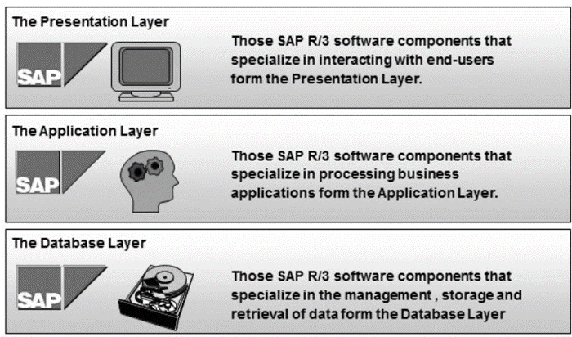
SAP Layered Architecture
SAP Three-Tier Architecture
With SAP R/3, SAP ushers in a new generation of enterprise software — from mainframe computing (client-server architecture) to the three-tier architecture of database, application, and user interface.
Reference: https://www.tutorialspoint.com/sap/sap_architecture.htm

Slide 14
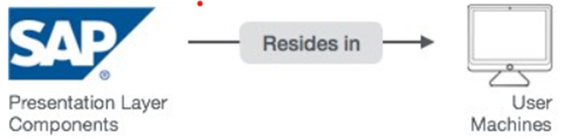
Presentation Servers
Presentation Layer is also known as client Layer
Presentation Layer is a user interaction
In SAP-User interaction purpose we use GUI
Reference: https://www.tutorialspoint.com/sap/sap_architecture.htm

Slide 15
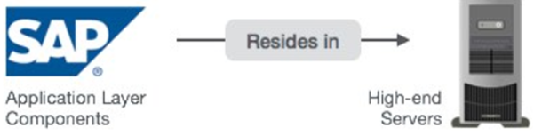
Application Layer is also known as Kernel Layer and Basic Layer.
SAP application programs are executed in Application Layer.
Application Layer serves as a purpose of a communicator between Presentation and Database Layer.
Application Servers
Reference: https://www.tutorialspoint.com/sap/sap_architecture.htm

Slide 16
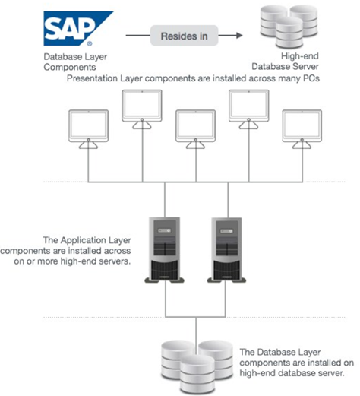
Database Servers
Database layer stores the data
Data store can be Business data, SAP system data, SAP tables, Programs.
Examples − Oracle, Microsoft SQL Server, IBM DB/2, Siebel, Sybase, etc.
Reference: https://www.tutorialspoint.com/sap/sap_architecture.htm

Slide 17
Functional Module
In order to replicate and enable business process, SAP offers various predefined or standard functionality to help departments in performing various business activities.
The SAP modules which provide predefined standard functionality to replicate actual business activity are called functional module.
Technical Module
These modules do not directly replicate actual business activity but provide needed support to functional modules.
They enable technical consultants to maintain and tune your landscape, schedule tasks, troubleshoot performance issues, build applications, download and install updates, and plan and execute migrations.

Slide 18
References
1. https://www.sap.com/india/about/company/what-is-sap.html
2. https://www.investopedia.com/terms/e/erp.asp
3. https://www.g2.com/categories/erp-systems

